Slide 1
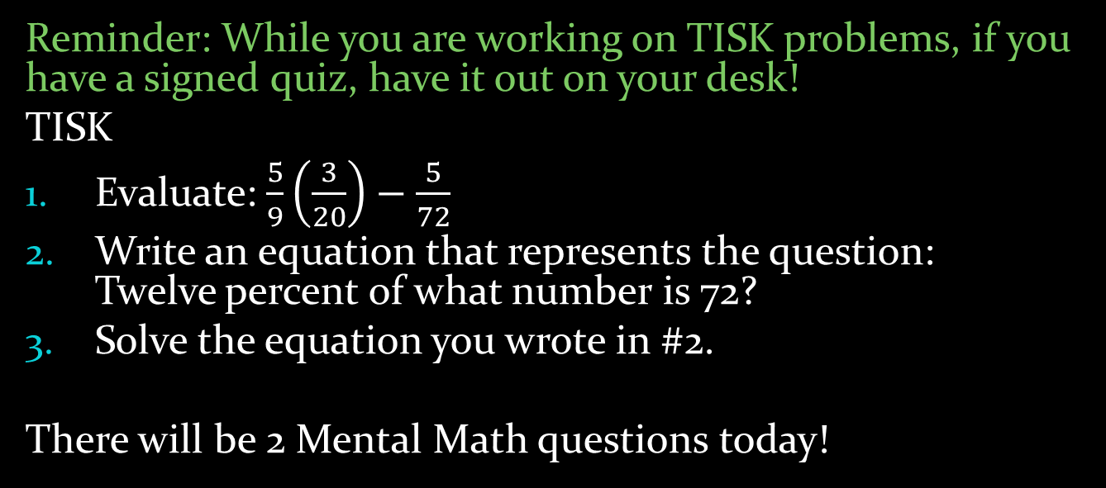
Monday, October 29, 2012
Reminder: While you are working on TISK problems, if you have a signed quiz, have it out on your desk!
TISK
Evaluate: $\frac{5}{9}\left(\frac{3}{20}\right)−\frac{5}{72}$
Write an equation that represents the question: Twelve percent of what number is 72?
Solve the equation you wrote in #2.
There will be 2 Mental Math questions today!
Homework: Combinations & Permutations worksheet
Notes:
Mental Math
1.) Multiply -3 and -8. Divide by -2. Add 21. Take the square root. (3)
2.) Multiply -2 and -9. Divide by -6. Add -12. Add 40. Take the square root. (5)

Slide 2

Homework Check
120
$\frac{1}{110}$
Not a permutation
336
$\frac{1}{24}$
Not a permutation

Slide 3
§9-6 Combinations
So what do we do when order ISN’T important?
Look at #3 from last night’s homework:
A frozen yogurt stand sells 14 flavors. How many different flavored combinations of 2 scoops of frozen yogurt could you get?
The problem is that choosing vanilla then chocolate is essentially the same as choosing chocolate then vanilla.
Therefore, we will use a combination rather than a permutation to find how many unique combinations are possible.

Slide 4

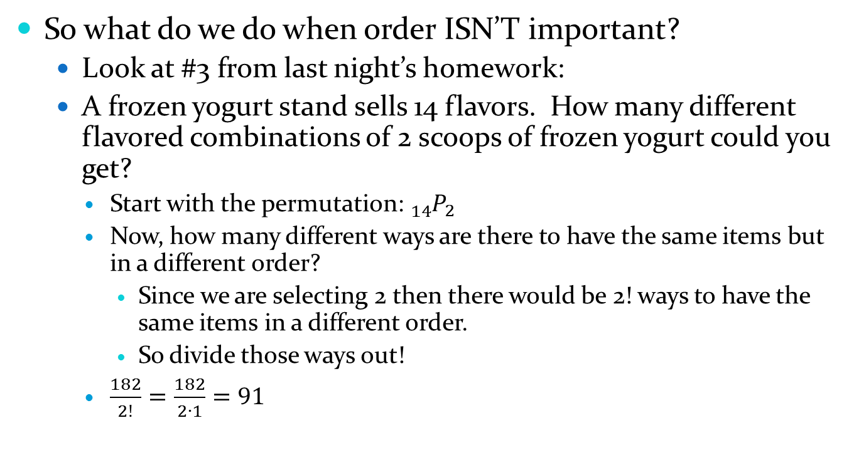



§9-6 Combinations
So what do we do when order ISN’T important?
Look at #3 from last night’s homework:
A frozen yogurt stand sells 14 flavors. How many different flavored combinations of 2 scoops of frozen yogurt could you get?
Start with the permutation: ${}_{14}^{}{P_{2}}$
Now, how many different ways are there to have the same items but in a different order?
Since we are selecting 2 then there would be 2! ways to have the same items in a different order.
So divide those ways out!
$\frac{182}{2!}=\frac{182}{2∙1}=91$
$$=\frac{14!}{\left(14−2\right)!}$$
$$=\frac{14!}{12!}$$
$$=14∙13$$
$$=182$$

Slide 5

§9-6 Combinations
That’s the formula!
A combination of n items taken r at a time (or a combination of n choosing r) is:
${}_{n}^{}{C_{r}=\frac{{}_{n}^{}{P_{r}}}{r!}}$

Slide 6
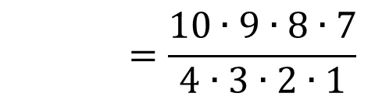
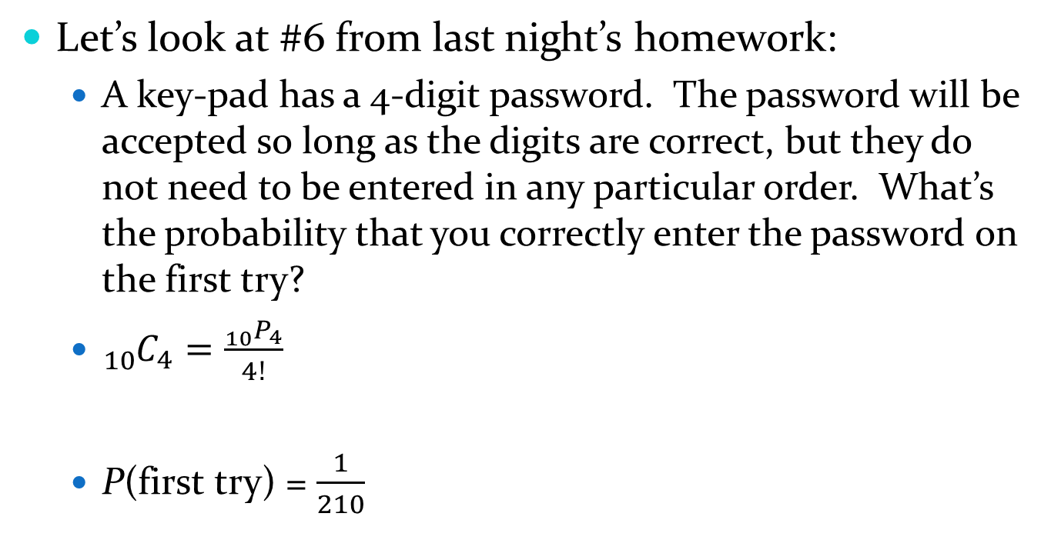

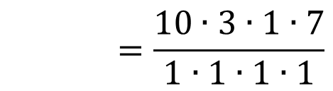
§9-6 Combinations
Let’s look at #6 from last night’s homework:
A key-pad has a 4-digit password. The password will be accepted so long as the digits are correct, but they do not need to be entered in any particular order. What’s the probability that you correctly enter the password on the first try?
${}_{10}^{}{C_{4}=\frac{{}_{10}^{}{P_{4}}}{4!}}$
P(first try) = $\frac{1}{210}$
3
$$=\frac{10∙9∙8∙7}{4∙3∙2∙1}$$
$$=\frac{10∙3∙1∙7}{1∙1∙1∙1}$$
$$=210$$

Slide 7
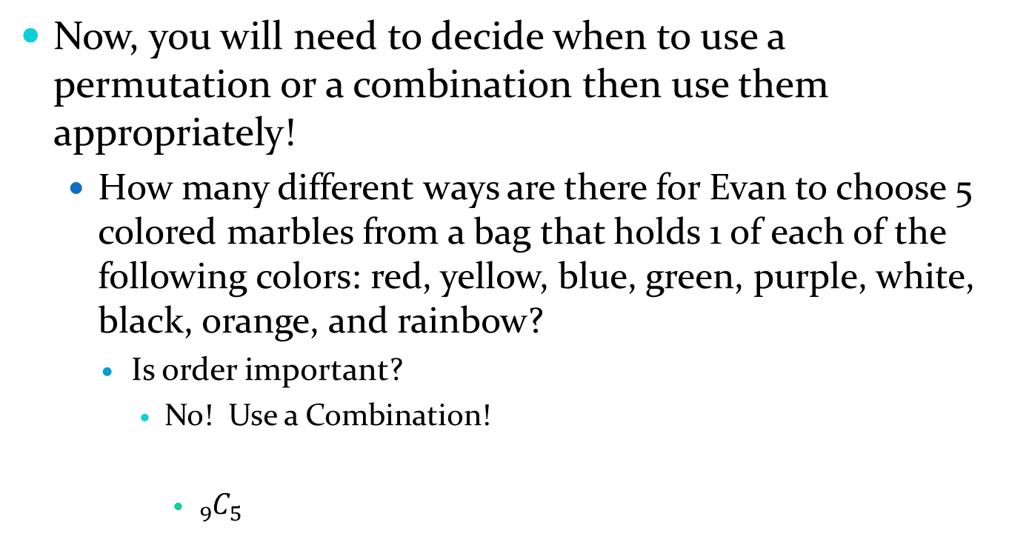




§9-6 Permutations & Combinations
Now, you will need to decide when to use a permutation or a combination then use them appropriately!
How many different ways are there for Evan to choose 5 colored marbles from a bag that holds 1 of each of the following colors: red, yellow, blue, green, purple, white, black, orange, and rainbow?
Is order important?
No! Use a Combination!
${}_{9}^{}{C_{5}}$
2
$$=\frac{{}_{9}^{}{P_{5}}}{5!}$$
$$=\frac{9∙8∙7∙6∙5}{5∙4∙3∙2∙1}$$
$$=\frac{9∙2∙7∙1∙1}{1∙1∙1∙1∙1}$$
$$=126$$
Notes:
3(2) = 6 cancels first
Then 5’s
Then 4 and 8

Slide 8


§9-6 Permutations & Combinations
How many different ways are there to arrange the first row of these crayons (using all possible colors seen)?
Is order important?
Yes! Use a permutation!
${}_{13}^{}{P_{7}}$
$$=13∙12∙11∙10∙9∙8∙7$$
= 8,648,640

Slide 9
Homework
Permutations & Combinations Worksheet

